Slide 1
Annual Troop
Program Planning

Slide 2
Annual Troop Program Planning
University of Scouting 2016
Bob Quick BS309
What is Participants Scouting Resume
Name
Current Position
How Long in that position
Past Scouting Experience (including as a youth)
What do you expect to get out of this program today?
PLEASE make sure you’re signed in and that your information is correct so you get credit for today’s training!!!

Slide 3
Annual Troop Program Planning
Annual Planning has a couple of reasons to be done
One is if you’re interested in Journey to Excellence points
Have a program plan and budget – need a “plan” to project a budget
Two is, for the time being, the 2016 Unit Challenge for Erie Shores
you need a 2017 Program Calendar
you need to schedule your FOS for next year
According to BSA (national website) ~ PLANNING
I recommend not just a 12 month plan, but possibly an 18 month plan/outlook
Why 18? Some locations book up early and you need to get on them fast
remember NOTHING is cast in stone ~ Semper Gumby!
When?
Early fall after the new Scouts from the spring cross over have some experience?
Spring before the new Scouts cross over?
Maybe right after unit elections so the new youth leadership an plan their own program and expectations?
Regardless of when – do it and do it consistently, don’t make it an all day effort (break it up if necessary), and you may need to…

Slide 4
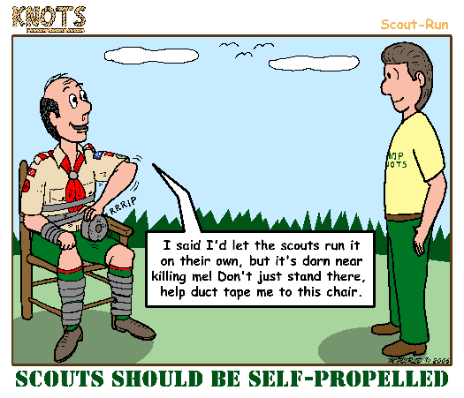
Annual Troop Program Planning

Slide 5
Annual Troop Program Planning
My recommendation is, if your unit is large enough and mature enough – always use the Patrol Method. If not it may be an “all hands” effort for all the Scouts.
Just try to avoid the Adults commandeering the effort; let the SPL lead!!!
Next – have the Scouts focus on goals in terms of the Long Term plans such as High Adventure in 2019 and then the Short Term plans for monthly activities.
Long Term is usually more focused for High Adventure and requires the “crew” have a slot to use… plus isn’t usually cheap so planning is needed.
Short Term is not hard – Monthly plans for the next 12 to 18 months
Start out with Council/District events (camporalls/camporees) and Summer Camp which can pre-plan 3 to 4 months out of 12 for you.
Then go to monthly plans for more individual plans. These too could require more planning and lead time.
Add into the Monthly Plans any special events like Courts of Honor or Friends of Scouting presentations

Slide 6
Annual Troop Program Planning
What will your Scouts do during the year?
Where will the go?
Where can they get ideas if they’re not too sure?.... Network with their buddies
As the leader / adult you’re not running their meeting for them this way, but encourage them to network at district events of what their fellow Scouts do, where they do it, etc.
Don’t reinvent the wheel if someone else is doing it and then you can always tap into that unit for background, info, etc
The Order of the Arrow Lodge used to post a Where to Go Camping guide
New / young unit?
As leaders ask yourself at Roundtable or Camporees; other leaders with more experience can offer suggestions
Watch for special events and show it to the Scouts as an idea
one suggestion is Davis-Besse Atomic Energy Camporee (www.dbaec.org)
Brainstorm with the Scouts what they’d like to do (works for all ages) and then divide up the ideas by season and/or possible age & experience requirements
Done yet? Probably not….

Slide 7
Annual Troop Program Planning
May sound all to simple and easy, doesn’t mean it works without some patience.
So now the Scouts, in some way, vote or select their plans
Nothing says they can’t have tentative plans for the following year because they had more ideas than months available (remember 18 month plan?)
Make sure, as the Adults in the room, that plans are practical and within reason. Sorry guys, no paintball and going to Hawaii maybe a stretch. This is why the SM and ASM(s) sit in – the adults who have the job of keeping it safe.
Remember, each activity needs at least _____ adults and/or to go with another unit who has _____ adults (darn old YPT)
Now we have the Troop (PLC hopefully) presenting their Plan to the Unit Committee for approval and support.
Remember the roles of the SM/ASM and Committee?
Announce/Publish the Annual Plan to the Troop, Institution and PARENTS.
From there the PLC can plan their Monthly Plans for Troop Meetings to prepare for their events and regular Troop Meetings.

Slide 8
Five Steps of Annual Troop Program Planning
Annual Troop Program Planning
Do your homework
Get patrol input
Hold an annual planning meeting
Consult with the troop committee
Announce the plan
This section goes into some detail already covered and, to some degrees drills down to the weekly level too. Some of it is also the Adult level effort (where’s that Duct Tape?)

Slide 9
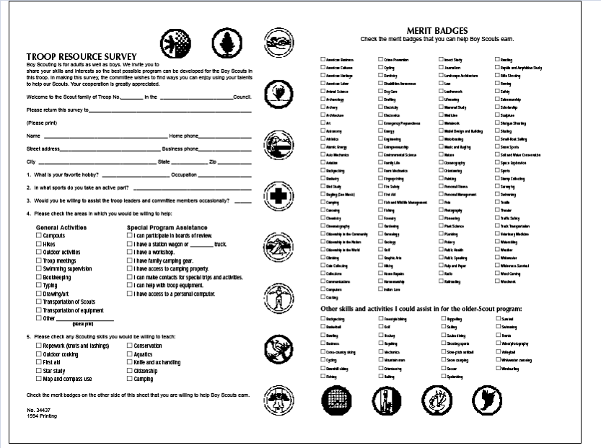
Do your homework
Annual Troop Program Planning
Conduct a Troop Resource Survey

Slide 10
Other Planning Items to Consider
Annual Troop Program Planning
Boards of review not youth/PLC
Courts of honor
Year-round recruiting plan not youth/PLC
Webelos-to-Scout transition not youth/PLC
Monthly activities
Service/conservation project not youth/PLC
Troop Junior Leadership Training maybe…
Planning for Diversity not youth/PLC

Slide 11
Your Primary Planning Tools
Annual Troop Program Planning
The Scoutmaster Handbook
Troop Program Features
Troop Program Resources
Council and District calendars
Get a copy of each school’s calendar and compare
Other calendars (church, charter organization, etc)

Slide 12
Types of Outdoor Activities
Annual Troop Program Planning
What are typical Scout outdoor activities? For younger Scouts, less-rugged activities are more appropriate as they begin to acquire outdoor knowledge and skills. These may include:
Day hikes—Reasonably short hikes (3 to 10 miles) in terrain without a lot of elevation gain or loss.
Service projects—Daylong projects that may be related to conservation, food collection, building shelter, or healthy living activities.

Slide 13
Types of Outdoor Activities
Annual Troop Program Planning
Patrol activities—A Boy Scout patrol or Varsity Scout squad may hike or camp with other patrols or squads in the unit or, with the permission of their Scoutmaster and parents or guardians, may hike or camp on their own. Or go bowling, see a movie, etc as long as it is follows the Guide to Safe Scouting.

Slide 14
Outdoor Activities – Con’t
Annual Troop Program Planning
Summer camp—Summer camp is what many Scouts enjoy most. Camp programs provide numerous opportunities for Scouts to earn merit badges along their advancement trail. Resident Scout camping includes at least five nights and six days of fun outdoor activities.

Slide 15
Outdoor Activities – Con’t
Annual Troop Program Planning
Weekend overnights—Troops that plan and carry out outings once a month attract and retain boys at a much higher level than those that have fewer outings during the year.
Camporees—Councils and districts plan camporees and other outings during the year that give Scouts an opportunity to test their knowledge and skills in competitive events with other troops and patrols.

Slide 16
Outdoor Activities – Con’t
Annual Troop Program Planning
Council high adventure—A high-adventure experience includes at least five nights and six days of trekking in wilderness and other rugged, remote locations. Trekking may include backpacking, canoeing, mountain biking, horse packing, mountain climbing, ski touring, rafting, kayaking, or a host of other outdoor adventures. Minimum age requirements are typical.

Slide 17
Outdoor Activities – Con’t
Annual Troop Program Planning
National high adventure—The BSA operates national high-adventure bases and programs. With two locations in the Florida Keys, the Florida National High Adventure Sea Base offers a variety of aquatic and boating programs. The Northern Tier National High Adventure Program, based in northern Minnesota with two satellite bases in Canada, provides a variety of canoe treks and programs. Philmont Scout Ranch and the Double H Ranch in the mountains of New Mexico provide excellent backpacking treks. Minimum age requirements vary, but most programs are rugged and designed for older Scouts. And the relatively new Bechtel Summit Reservation in West Virginia.

Slide 18
Outdoor Activities – Con’t
Annual Troop Program Planning
Unit high adventure—The highest level of challenge for a troop or team is to plan and carry out its own high-adventure experience. These activities for more experienced Scouts are planned and implemented by youth members with coaching from their adult leaders.

Slide 19
Example Annual Planning Meeting
Annual Troop Program Planning
There are many approaches to preparing an annual program plan for a troop. This agenda is offered as one method that has worked well. Some troops have this meeting in early January and plan a program for the full calendar year. Other troops follow the National BSA guidelines and have their planning meeting in the fall and follow the school year.
8:00 - 11:00 PLC Planning Meeting
11:00 - 1:00 Scoutmaster Lunch
1:00 - 3:00 Troop Committee Meeting

Slide 20
PLC Planning Meeting
Annual Troop Program Planning
The PLC should review with their Patrols in advance:
What activities went very well last year?
What Scouting Skills does the troop excel at?
Which activities had shortcomings? What improvements are needed?
Do any Scouting Skills need special attention in the coming year?
How well are the meetings run? Is it a "Scout led" troop? What improvements are needed?
Are any training needs identified?
Report from the Advancement Chairman: Is the troop lacking certain rank related activities? Are there any specific Eagle required merit badges that a number of Scouts lack?
From a list of activities done over the last three years, which should be repeated?
Any new ideas?

Slide 21
PLC Planning Meeting (con't)
Annual Troop Program Planning
Goals
What specific goals does the troop want to accomplish in the following year? For example: improve open fire cooking skills. Or travel lighter with less use of bulky troop equipment.
Does the PLC want to name a theme for the program year? Such as: backpacking, cycling, or canoeing. Such themes can be used to prepare for the troop high adventure trip the following year.

Slide 22
PLC Planning Meeting (con't)
Annual Troop Program Planning
Troop Calendar - events with known dates
Summer camp (June/July)
Council or District Camporees
Camp Alaska (January ?)
Davis-Besse Atomic Energy Camporee
Dorchester International Brotherhood Camporee (DIBC)
Put-In-Bay Camporee
Scouting for Food (Fall or Spring)
Troop Junior Leader Training if you hold your own
High Adventure (summer)
Scout Sunday (February)
Troop service projects planned

Slide 23
PLC Planning Meeting (con't)
Annual Troop Program Planning
Troop Calendar - new activities for this year
Outdoor program for the months without an activity already planned
Other troop service projects
Court of Honors (after summer camp; after winter/merit badge camps; third in the fall)
Troop elections (every five to six months)
What merit badges does the PLC want to focus on at the meetings this year?
Troop Calendar - future years
High Adventure activity for next year - what preparation must be done now?
High Adventure activity for the year after next - what are the possibilities?

Slide 24
Scoutmaster Buy-In
Annual Troop Program Planning
Meet with the Scoutmaster and Assistant Scoutmasters
Any problem areas that need to be discussed among the adult leaders?
What are the troop's equipment needs?
Review of proposed outdoor program and acceptance of responsibility by at least two adults to act as Tour Leaders for each of the scheduled events. (Reduces the work that the Scoutmaster has to do later in carrying out the troop program.)

Slide 25
Troop Committee Meeting
Annual Troop Program Planning
The SPL should present the proposed Troop Calendar to the Troop Committee for review and approve
Remember the Annual District meeting and/or dinner. Schedule time to identify adult leaders for recognition and/or service awards
Review funds needed for the proposed new equipment
Annual troop fund-raisers (garage sale, popcorn, other?)
Summary of proposed service projects
Troop dinners in conjunction with the Court of Honors
Adult leader training, including Roundtable and University of Scouting

Slide 26
Communicate!
Annual Troop Program Planning
Don’t forget to communicate your Troop’s approved Annual Plan using the Troop Scribe
Remember to send the Plan again periodically as a reminder and to inform new scouts of upcoming events
Distribution list should include: registered scouts and parents, Chartered Organization representative, District Commissioner, troop alumni and troop webmaster

Slide 27
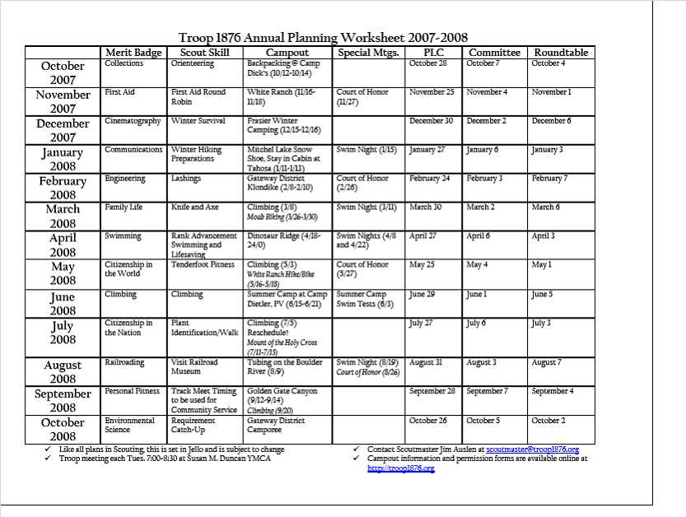
Annual Troop Program Planning
Example

Slide 28
Annual Troop Program Planning
Course Disclaimer
Instructor Introduction
I am not a paid profession. I am a volunteer just like you.
Instructor Scout Experience
There is no “right” method, there are different techniques and we’ll go over some today
QUESTIONS? You can always get me through the Troop/Pack 208 website or my email address
webmaster@swantonscouts.org

